Slide 1
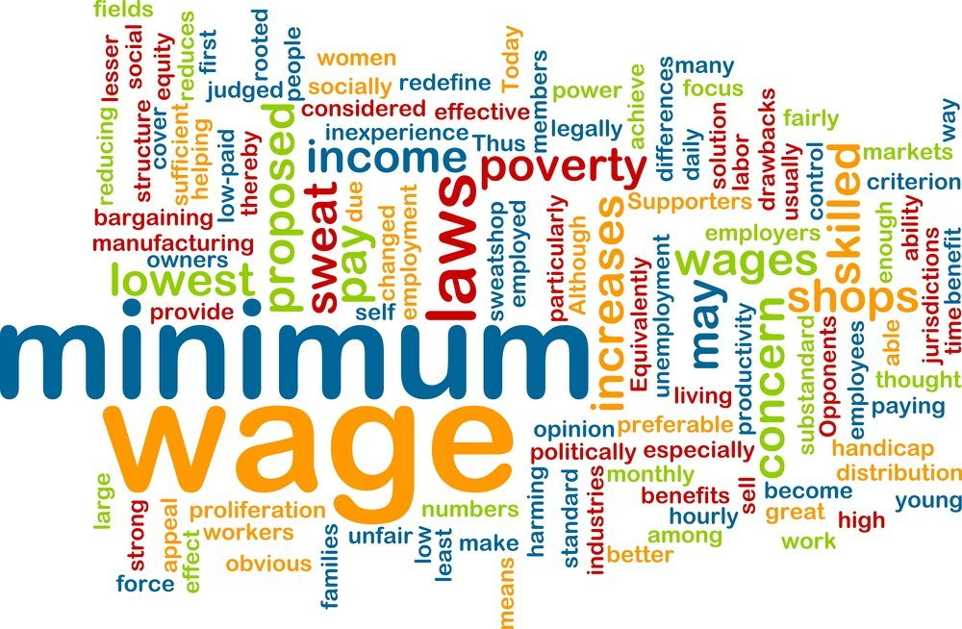
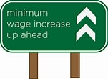
Minimum Wage
Austin University Area Rotary Club, Austin, TX
May 17, 2021
Veronika Dolar, Ph.D.

Slide 2
National Economic Education Delegation
Vision
One day, the public discussion of policy issues will be grounded in an accurate perception of the underlying economic principles and data.
Mission
NEED unites the skills and knowledge of a vast network of professional economists to promote understanding of the economics of policy issues in the United States.
NEED Presentations
Are nonpartisan and intended to reflect the consensus of the economics profession.

Slide 3
Who Are We?
Honorary Board: 53 members
2 Fed Chairs: Janet Yellen, Ben Bernanke
6 Chairs Council of Economic Advisers
Furman (D), Rosen (R), Bernanke (R), Yellen (D), Tyson (D), Goolsbee (D)
3 Nobel Prize Winners
Akerlof, Smith, Maskin
Delegates: 585+ members
At all levels of academia and some in government service
All have a Ph.D. in economics
Crowdsource slide decks
Give presentations
Global Partners: 44 Ph.D. Economists
Aid in slide deck development

Slide 4
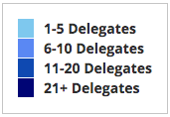
Where Are We?

Slide 5
Available NEED Topics Include:
Coronavirus Economics
US Economy
Climate Change
Economic Inequality
Economic Mobility
Trade and Globalization
Trade Wars
Immigration Economics
Housing Policy
Federal Budgets
Federal Debt
Black-White Wealth Gap
Autonomous Vehicles
US Social Policy

Slide 6
Credits and Disclaimer
This slide deck was authored by:
Jon Haveman, NEED
Disclaimer
NEED presentations are designed to be nonpartisan.
It is, however, inevitable that the presenter will be asked for and will provide their own views.
Such views are those of the presenter and not necessarily those of the National Economic Education Delegation (NEED).

Slide 7
Outline
What is the minimum wage?
Origin story
Limitations
Excluded occupations/sectors
Different mins for diff occupations
Effects of increasing
racial impacts
Economist’s perspective

Slide 8
What Is The Minimum Wage?
The minimum wage is an example of a price control and sets a wage floor.
It is unlawful for businesses in covered industries to pay a wage below the minimum.
The Federal minimum wage is currently $7.25.
Minimum wage of $2.13 for tipped workers with the expectation that wages plus tips total no less than $7.25 per hour. The employer must pay the difference if total income does not add up to $7.25 per hour.

Slide 9
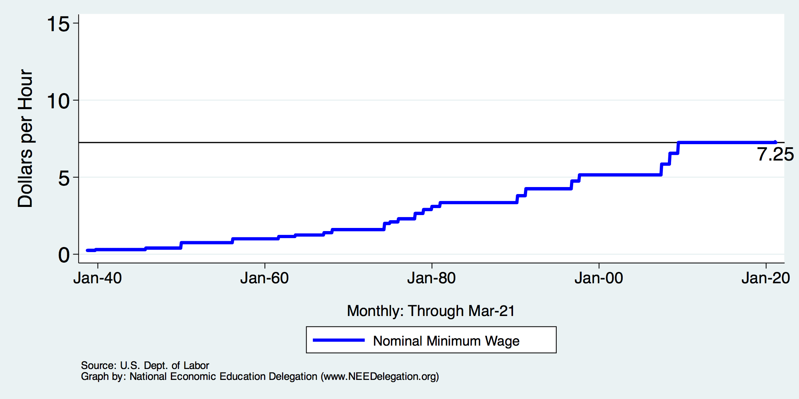
Nominal Minimum Wage Over Time

Slide 10
Correcting Variables for Inflation: Comparing Dollar Figures from Different Times
Inflation makes it harder to compare dollar amounts from different times.
Example: the minimum wage
$1.15 in December 1964
$7.25 in April 2021
Did min wage have more purchasing power in December 1964 or May 2021?
To compare, use CPI to convert 1964 figure into “today’s dollars”…
CPI is Consumer Price Index: a measure of the overall cost of the goods and service bought by a typical consumer

Slide 11
Correcting Variables for Inflation: Comparing Dollar Figures from Different Times
Amount in today’s dollars
Amount in year T dollars
CPI is Consumer Price Index: a measure of the overall cost of the goods and service bought by a typical consumer
CPI today
=
x
CPI in year T
In our example,
“year T” is December 1964, “today” April 2021
Min wage was $1.15 in year T
CPI = 31.3 in year T, CPI = 266.8 today
The minimum wage in 1964 was $9.80 in today’s (2021) dollars.
266.8
$9.80
=
$1.15
x
31.3

Slide 12
Correcting Variables for Inflation: Comparing Dollar Figures from Different Times
Researchers, business analysts, and policymakers often use this technique to convert a time series of current-dollar (nominal) figures into constant-dollar (real) figures.
They can then see how a variable has changed over time after correcting for inflation.
Example: the minimum wage, from Jan 1960 to 2021…

Slide 13
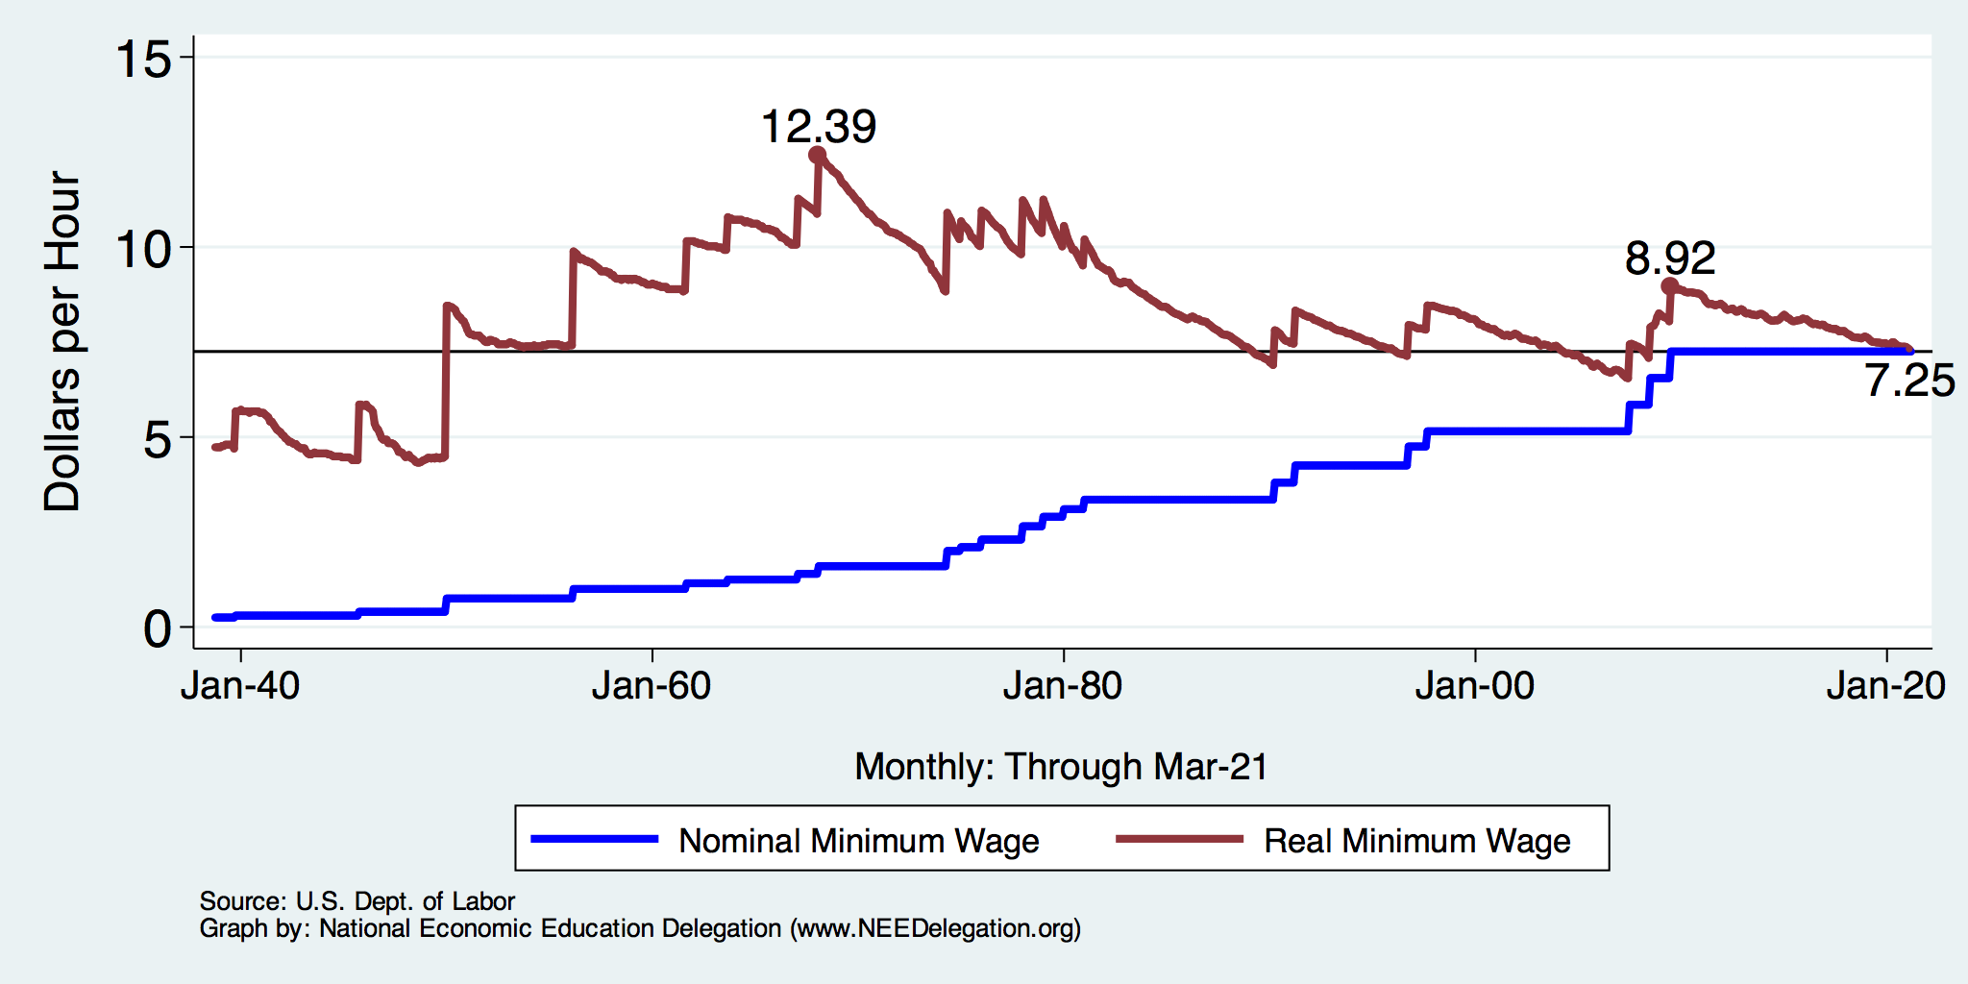
History of the Minimum Wage

Slide 14
Real Annual Minimum Wage in 1968 was
$12.39 x 40 hours per week x 52 weeks = $20,771
Real Annual Minimum Wage today is
$7.25 x 40 hours per week x 52 weeks = $15,080

Slide 15
U.S. Minimum Wage in Global Context

Slide 16
U.S. Minimum Wage in Global Context

Slide 17
U.S. Minimum Wage in Global Context

Slide 18
How Many are Paid At or Below Min. Wage?
1980: 15%
1991: 8.4%
2010: 6%
2019: 1.9%

Slide 19
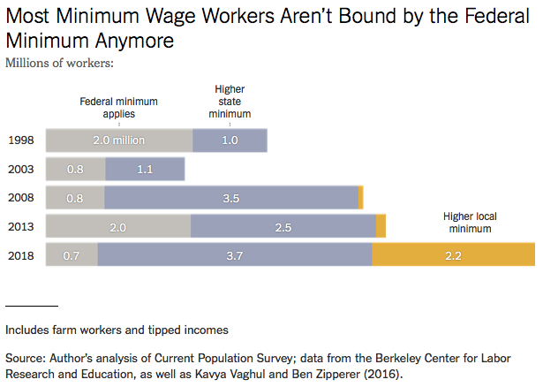
Notes:
https://www.nytimes.com/2019/04/24/upshot/why-america-may-already-have-its-highest-minimum-wage.html?action=click&module=RelatedLinks&pgtype=Article

Slide 20
Many States Have A Higher Min Wage
NY: $12.50/hour
States with Higher
Minimum Wage
than Federal
CA: $13/hour
States with Same
Minimum Wage
as Federal
States with no Minimum Wage
As of Jan 1, 2021
Source: U.S. Department of Labor

Slide 21
Minimum Wage in Florida
Florida’s minimum wage rate is currently is $8.56.
On November 3, 2020, over 60 percent of Floridian voters approved Amendment 2, which increases the minimum wage and amends Florida’s Constitution.
Employers must use the following hourly minimum wage schedule for non-tipped employees:
Through December 31, 2020 – $8.56
January 1, 2021 – $8.65
September 30, 2021 – $10.00
September 30, 2022 – $11.00
September 30, 2023 – $12.00
September 30, 2024 – $13.00
September 30, 2025 – $14.00
September 30, 2026 – $15.00

Slide 22
States WITHOUT Minimum Wage Laws
 | Share of Population That is Black
Alabama | 26.6%
Louisiana | 32.2%
Mississippi | 37.7%
South Carolina | 27.0%
Tennessee | 16.7%
United States | 13.4%

Slide 23
Important Questions:
What is the purpose of a minimum wage?
Why do we have one?
What are the implications of having one?
Should we have one?
How high should it be?

Slide 24
Minimum Wage: Purpose
International Labor Organization:
The purpose of minimum wages is to protect workers against unduly low pay. They help ensure a just and equitable share of the fruits of progress to all, and a minimum living wage to all who are employed and in need of such protection.
Minimum wages can also be one element of a policy to overcome poverty and reduce inequality, including those between men and women, by promoting the right to equal remuneration for work of equal value.

Slide 25
Origin Story: The New Deal
Minimum wages
Social Security
Unemployment

Slide 26
Fair Labor Standards Act of 1938
Minimum wage: $0.25 – raised 22 times
“Covered” only about 23% of workers at the time.
The law did not apply universally.
11 million out of 48 million gainful workers were covered.
The provisions of the Act affect employees who are engaged in (interstate) commerce or the production of goods for (interstate) commerce.
Not covered were:
Farm labor, retail trade, domestic and personal service, governmental service, or the self-employed.
Source: Daugherty, The Economic Coverage of the Fair Labor Standards Act

Slide 27
Minimum Wages
1960s – great equalizer - MW increased in real terms 37% (8.9 to 12.24)
The 1966 Fair Labor Standards Act extended federal minimum wage coverage to agriculture, restaurants, nursing homes, and other services which were previously uncovered and where nearly a third of black workers were employed.
Since 1968 – has fallen 41% (12.18 to 7.25)
Or, in 1968, was 69% higher than it is today.
Exacerbating the Black-White wage gap.

Slide 28
Effects of 1966 Increase in Min Wage Coverage
Added coverage for agriculture
restaurants, nursing homes,
and other services.
These industries employed
1/3 of Black workers at the time.
Graph is the effect on wages
within these industries.
This explains 20% of reduced
Black-White wage gap during the
Civil Rights Era.

Slide 29
Should There be A Federal Minimum Wage?
Abolish a Federal minimum wage?
Argument in favor:
Cost of living differs across states.
Arguments against:
Could result in very different living standards across states.
Racial differences are a particular concern.
Monopsony in the labor market.
30% of labor force will already be under a $15 min wage by 2025.
California, Connecticut, Illinois, Maryland, Massachusetts, New Jersey, New York

Slide 30
States and Local Gov’ts are Raising Min Wages
Notes:
https://www.nytimes.com/2019/04/24/upshot/why-america-may-already-have-its-highest-minimum-wage.html?action=click&module=RelatedLinks&pgtype=Article

Slide 31
Common View of Minimum Wage
Wages go up.
Labor costs go up.
Employment falls and Unemployment increases.
Bottom line: are the increased wages worth the drop in employment?
This is a very SIMPLE view of the minimum wage.
Economics is complicated.

Slide 32
How Much Unemployment will the MW Create?
Very Elastic Supply and Demand
Very Inelastic Supply and Demand

Slide 33
Empirical Evidence
Belman and Wolfson perform meta-analysis combining results from 23 different studies that present their results in the same units (employment or hours of employment) and that report estimates for elasticities and their standard errors, and obtain 439 point estimates.
They find that once a correction for the publication bias and article-specific effects are incorporated, overall elasticities for the United States are statistically insignificant or are very close to zero and hence not economically meaningful. This result is true even when restricting the focus to teenagers and young adults.
More precisely, they find that a 10 percent increase in the minimum wage is associated with a reduction in employment or hours of employment between −0.0 and −2.6 percent but less than half of the estimates are statistically significant.
Of those estimates that are statistically significant, the range is between −0.1 percent and −0.03 percent.

Slide 34
Market Structure
The previous graphs and analysis using Supply and Demand assumes perfectly competitive labor market.
Numerous employers
Numerous workers
Each behaving as price taker and with no market power
Data shows that labor markets are very monopsonistic
Monopsony is when there is only one buyer or a single buyer that dominates the market.
Similar to monopoly, where there is only one seller.
Both monopoly and monopsony are an example of a market failure and provide inefficient market allocations.

Slide 35
Monopsony in the Labor Market and MW
Coal mine owner in town where coal mining is the primary source of employment.
The government in the employment of civil servants, nurses, police and army officers.
Walmart, Amazon, Uber
Universities
Hospitals
Even if a firm is not a pure monopsony, it may have a degree of monopsony power, due to geographical and occupational immobilities, which make it difficult for workers to switch jobs and find alternative employment.

Slide 36
Monopsony in the Labor Market and MW
Higher, well chosen minimum wage can raise employment in a labor market where firms enjoy monopsony power.
Seminal paper by Stigler (1946).

